Slide 3
Introduction to VCS, Git and Github
Rahul Bordoloi

Slide 4

Rahul Bordoloi
Data Science Intern, High Radius Corporation
Freelancer and Open Sourced Enthusiastic.
Currently a 4th Year Computer Science Undergrad at KIIT University, Bhubaneswar
Website: https://rahulbordoloi.me
GitHub: https://github.com/rahulbordoloi
LinkedIn: https://linkedin.com/in/rahulbordoloi
Mail: rahul.bordoloi@studentambassadors.com,
rahulbordoloi24@gmail.com

Slide 5
Let’s Get Started!

Slide 6
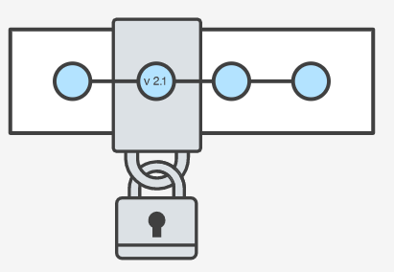
VCS (Version Control System)

Slide 7
Version Control System
Version control, also known as source control, is the practice of tracking and managing changes to software code.
Version control systems are software tools that help software teams manage changes to source code over time.
Version control software keeps track of every modification to the code in a special kind of database. If a mistake is made, developers can turn back the clock and compare earlier versions of the code to help fix the mistake while minimizing disruption to all team members.
Version control protects source code from both catastrophe and the casual degradation of human error and unintended consequences.

Slide 8
Contd ..
Software developers working in teams are continually writing new source code and changing existing source code. One developer on the team may be working on a new feature while another developer fixes an unrelated bug by changing code, each developer may make their changes in several parts of the file tree.
Version control helps teams solve these kinds of problems, tracking every individual change by each contributor and helping prevent concurrent work from conflicting. Changes made in one part of the software can be incompatible with those made by another developer working at the same time. This problem should be discovered and solved in an orderly manner without blocking the work of the rest of the team. Further, in all software development, any change can introduce new bugs on its own and new software can't be trusted until it's tested. So, testing and development proceed together until a new version is ready.

Slide 9
One of the most popular VCS tools in use today is called Git.

Slide 10
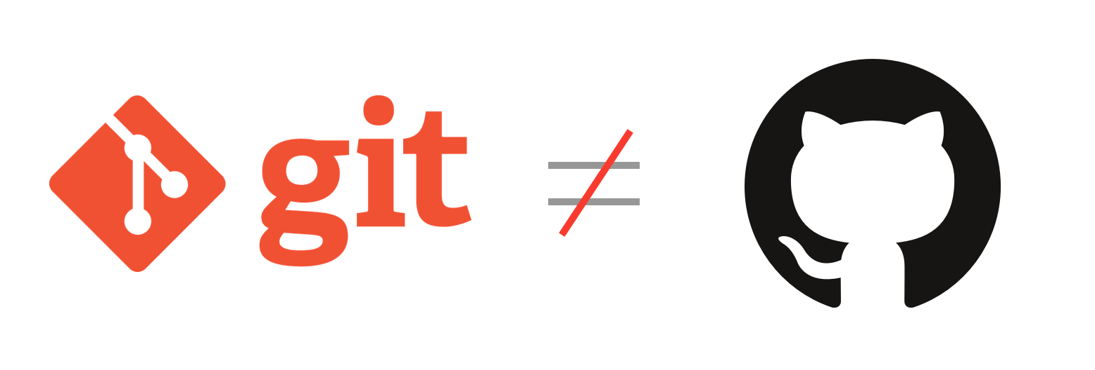
Now, Git is not GitHub!

Slide 11
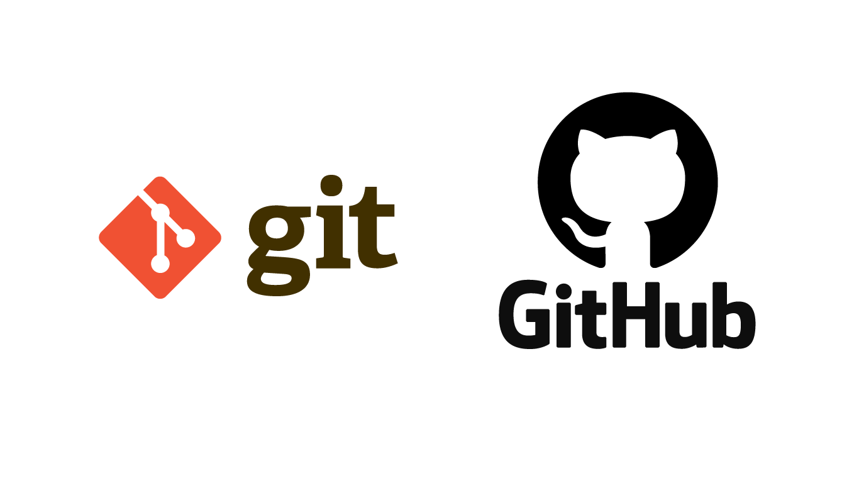
GIT and GitHub

Slide 12
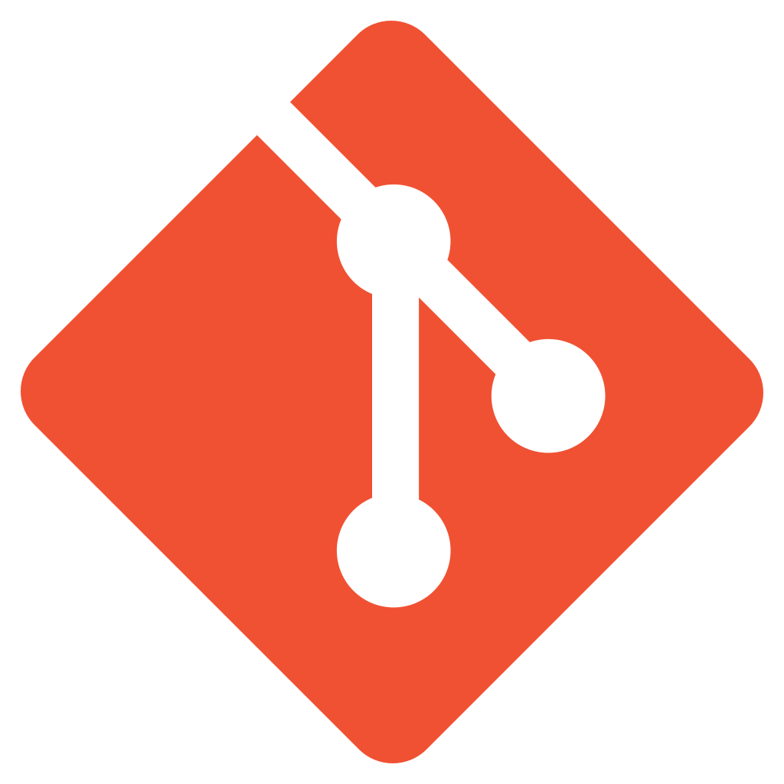
GIT
Like many of the most popular VCS systems available today, Git is free and open source that was started by Linus Torvalds—the same person who created Linux.
Git is a Distributed VCS, a category known as DVCS, more on that later.
Some of the Benefits –
A complete long-term change history of every file,
Branching and merging,
Traceability,

Slide 13
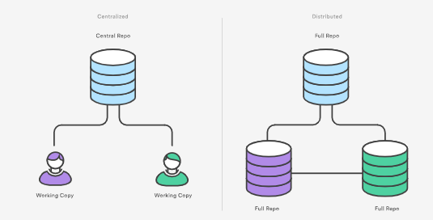
Git as a D-VCS
Having a distributed architecture, Git is an example of a DVCS (hence Distributed Version Control System). Rather than have only one single place for the full version history of the software as is common in once-popular version control systems like CVS or Subversion (also known as SVN), in Git, every developer's working copy of the code is also a repository that can contain the full history of all changes.

Slide 14
Installing GIT
Linux (Debian)
> $ sudo apt-get install git
Linux (Fedora)
> $ sudo yum install git
MacOS
https://git-scm.com/download/mac
Windows
https://git-scm.com/download/win

Slide 15
Some Important GIT Commands to start with
git init # Initialize a Repository
git add [file(s)] # To add files into your VCS
git commit –m “[message]“ # Committing Changes to your Files
git status # Checking the Status of your Files
git push # Pushing the Changes into Central Repo
git pull # Pulling in Files and Changes
git clone # Cloning a Repository
git remote add origin # Adding a remote repository
git checkout # Switching / Creating a New Branch
git restore # Restoring the Previous Changes

Slide 16
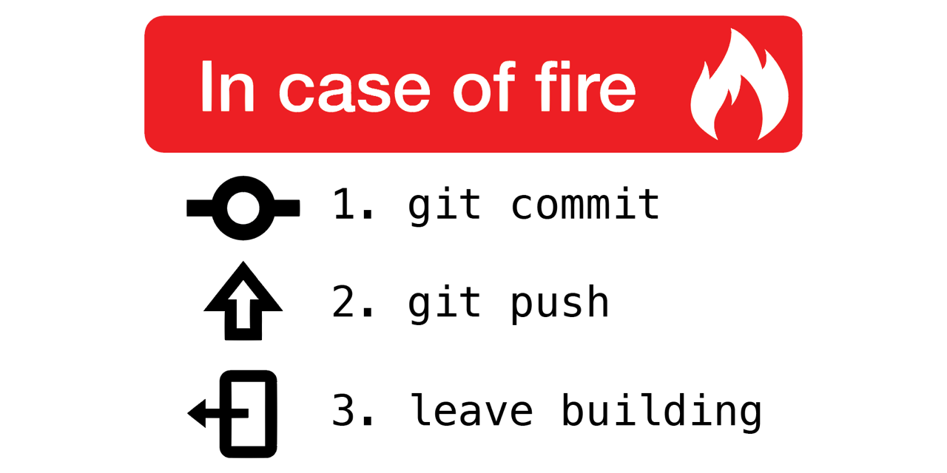

Slide 17

GitHub
Okay, But now. Then what’s GITHUB???!!
GitHub is to Git what Facebook is to your actual face. GitHub is designed as a Git repository hosting service.
It’s an online database that allows you to keep track of and share your Git version control projects outside of your local computer/server. Unlike Git, GitHub is exclusively cloud-based. Also, unlike Git GitHub is a for-profit service (although basic repository-hosting features are available at no cost to those who are willing to create a user profile, making GitHub a popular choice for open-source projects).

Slide 18
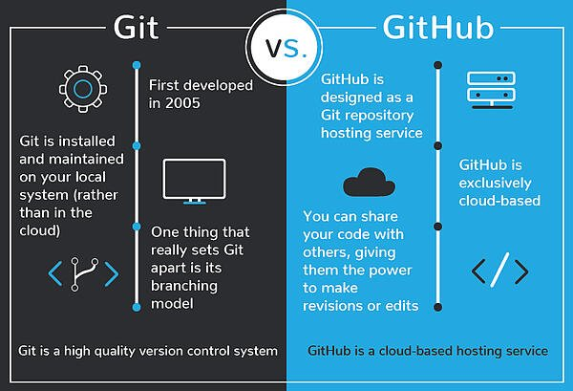

Slide 19
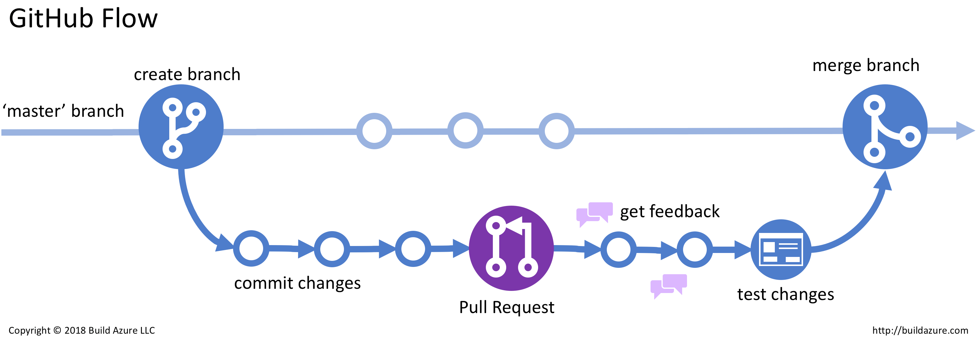
Understanding Basic Git-GitHub Workflow

Slide 20
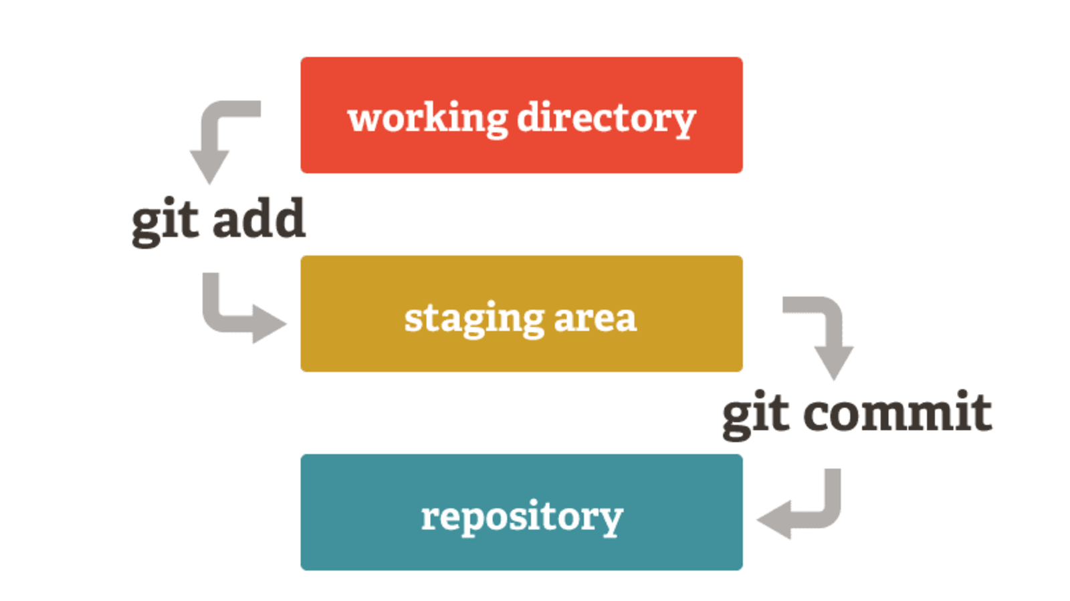

Slide 21
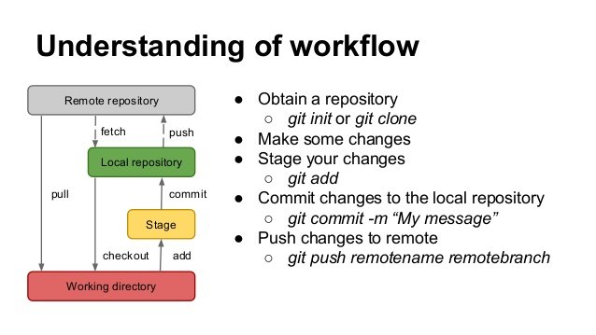

Slide 22
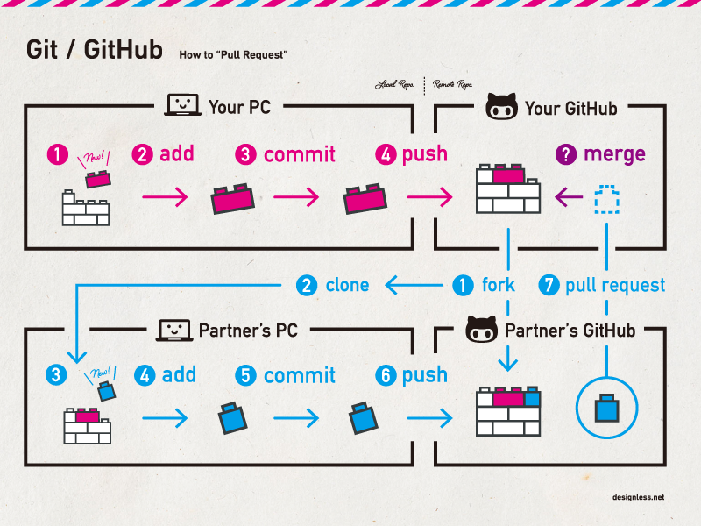
Demo Working of GIT and GitHub

Slide 23
Thank You!

